Slide 1
Nourish India
Rescuing Food, Restoring Hope.
Team name: ShivaSpear
By: Rohan Gaikwad, Satyam kadam, Swapnil Koli, Devshri Damle

Slide 2
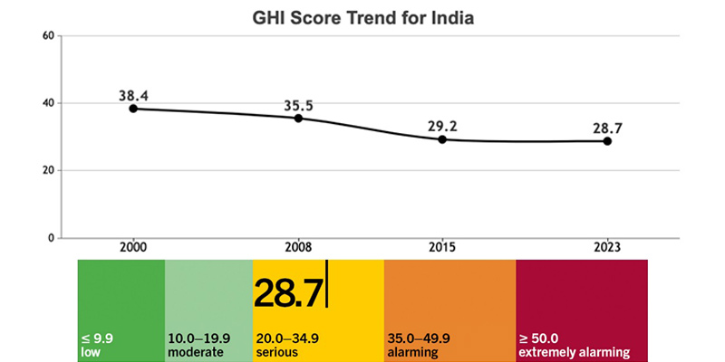
Our idea aims to connect the surplus with the deficit. India ranked 111 out of 125 in the 2023 Global Hunger Index (GHI) with a serious hunger score of 28.7, highlighting widespread food insecurity. Paradoxically, the UNEP Food Waste Index Report 2021 reveals that India wastes 68.8 million kg of food annually, contributing 7% to global food waste, underscoring the urgent need to bridge the gap between food wastage and hunger.. By directly connecting food companies to food banks and other donation centers we aim to eliminate supply chain issues and streamlining waste food quickly so that minimal lost can be created. Our service is unlike any other service offered in the status quo.
How it works
Our Mission
Two Side Connection
What sets us apart?
⬤ Our goal is to bring together
those with extra food to those who require food to minimize waste and better help our community. By working to reduce loss by sellers we are creating greater total benefit in our community furthering our sustainability together through collaboration.
⬤ Grocery Stores, Restaurants, etc…
We offer them a venue to upload a secure platform to share their information about foods, expiration dates, and other information which is key to the ability to transport and maintain this food.
⬤ Food banks and shelters
We allow banks to receive alternate venues for collecting donations and allow them to request certain foods based on their own banks abilities to store and maintain that food.
⬤ Our unique program serves as a middle man between stores and food banks and aims to streamline the working progress. Currently within the status quo very few grocery stores have their own donations to food banks. However these are often done by smaller companies and the larger ones are not following suit. By providing this service we aim to involve these bigger companies aiming to minimize the impact of these larger companies.

Slide 3
How we built it
Impact
Beginning Steps
Backend Development
Frontend Development
⬤ Our project bridges the gap between food surplus and hunger by efficiently connecting food companies with food banks and donation centers. By streamlining supply chains, we reduce wastage while ensuring nutritious food reaches those in need. This initiative improves food security, lowers India’s Global Hunger Index score, and minimizes environmental damage. It also benefits businesses by cutting disposal costs and promoting sustainable food management. With scalable potential, the project leverages technology for efficient tracking and distribution. By fostering responsible food consumption, we create a long-term impact, making food redistribution a sustainable solution to combat hunger and food wastage in India..
Brainstorming
XX%
Creating sign in page
Devising a system to clean the csv data
Wireframing
Using python to create the framework
Creating the food bank page and implementing the AI enabled search
XX%
Designating tasks to teammates
Developing Ai search feature
Creating the business dashboard to upload inventory
What languages/tools we used:
Html
CSS
CSV
Javascript
Python
Large language models (Open AI)
PHP

Slide 4
